Slide 1
2020 Democratic National Convention
An overview of the 2020 Democratic National Convention, including the impacts of coronavirus on the convention, key speakers, and the party platform voting process
August 12, 2020
Producer
GCSAA Government Affairs

Slide 2
Roadmap
Overview of US presidential elections
2020 primary in review
2020 look ahead

Slide 3
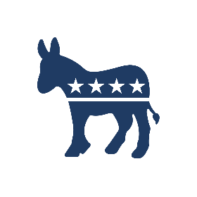
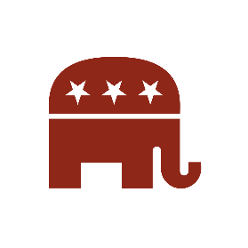
An overview of the US presidential election process
Step 1:
Primaries and Caucuses
DNC Primary
All Democratic delegates are allocated proportionally based on the outcome of each state’s primary contest
RNC Primary
GOP delegates are allocated either proportionally, via a winner-takes-all system, or a hybrid of the two
DNC National Convention
A candidate needs 1,991 pledged delegates to win
If no candidates wins a majority, the convention is contested and >2,375 pledged + unpledged delegates are needed to win
RNC National Convention
A candidate needs 1,276 delegates to win (pledged + unpledged)
Pledged delegates are bound to vote based on the results of their state primary in the first ballot, but are not bound in subsequent ballots
Step 2:
National Conventions
General Election
US citizens vote for the candidate of their choice, which translates into a vote for an elector
Electors from each state cast their vote for a candidate based on election results in their state
270 electoral college votes are needed to win
Step 3:
General Election
Sources: Ballotpedia; USA.gov.
Slide last updated on: February 13, 2020
Notes:
Sources:
“Democratic delegate rules, 2020,” Ballotpedia, Accessed February 13, 2020, https://ballotpedia.org/Democratic_delegate_rules,_2020
“Republican delegate rules, 2020,” Ballotpedia, Accessed February 13, 2020, https://ballotpedia.org/Republican_delegate_rules,_2020
“Presidential Election Process,” USA.gov, Accessed February 13, 2020, https://www.usa.gov/election

Slide 4
Democratic National Committee (DNC) rules on presidential primary delegates
How delegates are awarded to states: Each state is given delegates based on a formula factoring in the state’s popular vote for the Democratic nominee in the last three elections, the state’s electoral votes, and the date of the state’s primary
Types of delegates
1
Pledged delegates: Elected to the national convention during state primary contests and are “pledged” to a presidential candidate
Delegates needed to win
First ballot (pledged delegates only):
1,991 delegates needed
3,979 total delegates
Second ballot (pledged+unpledged):
>2,375 delegates needed
4,750 total delegates
Pledged district delegates: distributed & elected at the congressional or state legislative district level
Pledged at-large delegates: distributed and elected statewide
Pledged PLEO delegates: party leaders and elected officials that are often selected in a manner similar to at-large delegates
2
Automatic delegates (superdelegates): Unpledged delegates to the Democratic National Convention; unrequired to support a specific candidate
As of 2018, automatic delegates are no longer allowed to vote on the first ballot at a contested national convention
How delegates are allocated to candidates: For all Democratic primary contests, delegates are allocated proportionally based on the outcome of each state’s primary contest, with a 15% threshold typically required to be awarded any delegates
Sources: Ballotpedia.
Slide last updated on: February 12, 2020
Notes:
Sources:
“Democratic delegate rules, 2020,” Ballotpedia, Accessed February 13, 2020, https://ballotpedia.org/Democratic_delegate_rules,_2020

Slide 5
California has vastly more Democratic delegates than any other state
Number of pledged delegates by state, 2020 Democratic presidential primary
■ <50 ■ 50-150 ■ 150-250 ■ >250
Primary on Super Tuesday (Mar. 3)
Puerto Rico: 51
Guam: 7
Virgin Islands: 7
American Samoa: 6
Northern Marianas: 6
Democrats Abroad: 13
New York has 274 pledged Democratic delegates
WA
MT
ND
VT
ME
California has 415 pledged Democratic delegates
OR
MN
NH
ID
SD
WI
NY
WY
MI
NE
IA
PA
NV
UT
IL
IN
OH
MA
CA
CO
KS
MO
WV
VA
RI
KY
CT
TN
NC
NJ
AZ
NM
OK
AR
SC
MS
DE
AL
GA
MD
AK
TX
LA
DC
HI
FL
Sources: Ballotpedia.
Slide last updated on: February 12, 2020
Notes:
Sources:
“Democratic delegate rules, 2020,” Ballotpedia, Accessed February 13, 2020, https://ballotpedia.org/Democratic_delegate_rules,_2020

Slide 6
Roadmap
Overview of US presidential elections
2020 primary in review
Convention overview

Slide 7
Former VP Joe Biden has secured the necessary delegates to clinch the Democratic nomination
Candidate with the most delegates in each state
AS OF AUGUST 12, 2020
■ Biden ■ Sanders ■ Buttigieg
WA
MT
ND
VT
ME
OR
MN
NH
ID
SD
WI
NY
WY
MI
NE
IA
PA
MA
NV
UT
IL
IN
OH
CA
CO
WV
VA
RI
KS
MO
KY
CT
AZ
TN
NC
NJ
NM
OK
AR
SC
DE
MS
AL
GA
MD
AK
TX
LA
DC
HI
FL
Sources: The New York Times
Slide last updated on: August 12, 2020
Notes:
“Democratic Delegate Count and Primary Election Results 2020,” The New York Times, updated August 12, 2020,
https://www.nytimes.com/interactive/2020/us/elections/delegate-count-primary-results.html.

Slide 8
Former Vice President Joe Biden has officially received the required number of delegates to earn the Democratic nomination
■ Pledged Delegates allocated ■ Delegates remaining until 1,991
Data as of 8/12/20 as of 10:30AM
Sources: Associated Press.
Slide last updated on: August 12, 2020
Notes:
Source:
Associated Press Data, August 12, 2020 at 10:30 AM

Slide 9
Roadmap
Overview of US presidential elections
2020 primary in review
Convention overview

Slide 10
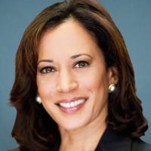
Democratic National Convention Overview
Presidential nomination
Impact of coronavirus on the convention
Former Vice President Joe Biden has amassed 2,671 delegates; 1,991 delegates are needed to win the nomination.
Postponed from original dates
In early April, the Democratic National Committee (DNC) announced that the convention would be postponed by a month
The convention was originally scheduled for July 13-16
On August 11, Biden announced that Sen. Kamala Harris (D-CA) would be his running mate. Harris dropped her presidential bid in December.
Changed venue
In late June, the DNC announced that state delegations should not plan to travel to Milwaukee and that their business at the convention would be conducted virtually
The event was moved from the 17,000-seat Fiserv Forum to the Wisconsin Center, which has a 4,500-seat theater and a 12,000-seat arena
Convention information
Dates:
August 17-20, 2020
Location:
Milwaukee, WI
Safety guidelines
On July 27, the DNC released conventions safety measures, including daily testing, mask requirements, and self-isolation prior to the event
Key speakers:
Michelle Obama, Sen. Bernie Sanders, John Kasich, Bill Clinton, Barack Obama
Available:
Live broadcast 9 p.m. EST each night on major television networks, social media sites, and streamed from the DNC’s website
Virtual speakers
On Aug. 5, the Democratic National Convention Committee announced that Biden and other speakers would not travel to Milwaukee
Sources: Vox, New York Times, Ballotpedia.
Slide last updated on: August 12, 2020
Notes:
Ella Nilsen and Nicole Narea, “The Democratic National Convention just announced its speaker lineup,” Vox, August 11, 2020,
https://www.vox.com/2020/8/11/21362326/democratic-national-convention-speaker-lineup-how-to-watch
Astead Herndon, Shane Goldmacher and Jonathan Martin, “Kamala Harris says she’s still ‘in this fight’ but out of the 2020 race,” New York Times, December 6, 2019,
https://www.nytimes.com/2019/12/03/us/politics/kamala-harris-campaign-drops-out.html
“Democratic National Convention, 2020” Ballotpedia, accessed August 12, 2020,
https://ballotpedia.org/Democratic_National_Convention,_2020#Media_coverage_of_possible_contested_convention
“Democratic National Convention 2020” Vox, accessed August 12, 2020,
https://www.vox.com/2020/8/11/21354671/democratic-national-convention-dnc-news

Slide 11
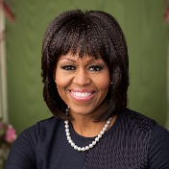
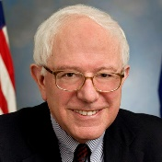
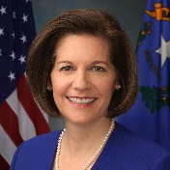
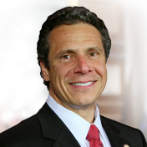
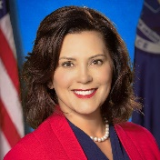
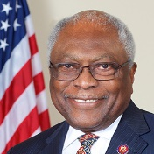
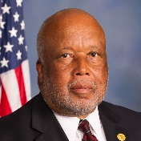
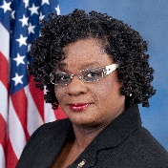
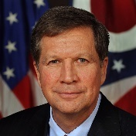
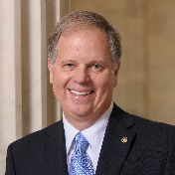
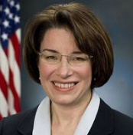
Monday, August 17: “We the People”
Key events
Opening ceremonies
Committee reports (Credentials, Rules and Platform)
Confirmed speakers
Former First Lady Michelle Obama
Keynote speaker
Senator Bernie Sanders (I-VT)
Senator Catherine Cortez Masto (D-NV)
Governor Andrew Cuomo (D-NY)
Governor Gretchen Whitmer (D-MI)
Rep. Jim Clyburn (D-SC-06)
Convention Chair Rep. Bennie Thompson (D-MS-02)
Rep. Gwen Moore (D-WI-04)
Former Governor John Kasich (R-OH)
Senator Doug Jones (D-AL)
Senator Amy Klobuchar (D-MN)
Sources: Democratic National Convention.
Slide last updated on: August 12, 2020
Notes:
“’Uniting America’—Democrats Announce Themes for Four Nights of Convention,” Democratic National Convention, August 7, 2020, https://www.demconvention.com/press-releases/uniting-america-democrats-announce-themes-for-four-nights-of-convention/.
“Democratic National Convention Announces 2020 Convention Officers, Schedule of Events,” Democratic National Convention, July 30, 2020, https://www.demconvention.com/press-releases/democratic-national-convention-announces-2020-convention-officers-schedule-of-events/.
“Democratic National Convention Schedule,” Democratic National Convention, accessed August 12, 2020, https://www.demconvention.com/schedule-and-speakers/?_sft_event-day=august-17.

Slide 12
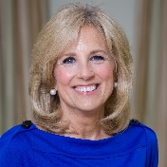
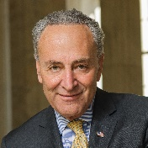
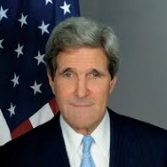
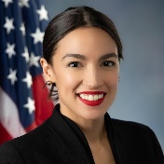
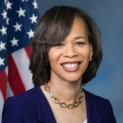
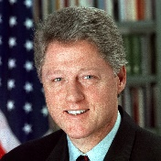
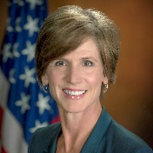
Tuesday, August 18: “Leadership Matters”
Key events
Keynote address
Presidential candidate nominating and seconding speeches
Roll call vote for the presidential nominee
Confirmed speakers
Former Second Lady Dr. Jill Biden
Keynote speaker
Minority Leader Chuck Schumer (D-NY)
Former Secretary of State John Kerry
Rep. Alexandria Ocasio-Cortez (D-NY-14)
Rep. Lisa Blunt Rochester (D-DE-AL)
Former President Bill Clinton
Former Acting U.S. Attorney General Sally Yates
Sources: Democratic National Convention.
Slide last updated on: August 12, 2020
Notes:
“’Uniting America’—Democrats Announce Themes for Four Nights of Convention,” Democratic National Convention, August 7, 2020, https://www.demconvention.com/press-releases/uniting-america-democrats-announce-themes-for-four-nights-of-convention/.
“Democratic National Convention Announces 2020 Convention Officers, Schedule of Events,” Democratic National Convention, July 30, 2020, https://www.demconvention.com/press-releases/democratic-national-convention-announces-2020-convention-officers-schedule-of-events/.
“Democratic National Convention Schedule,” Democratic National Convention, accessed August 12, 2020, https://www.demconvention.com/schedule-and-speakers/?_sft_event-day=august-18.

Slide 13
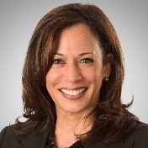
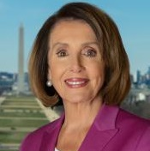
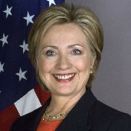
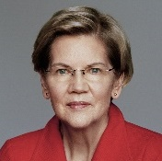
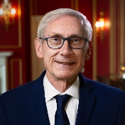
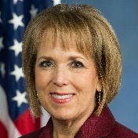
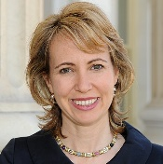
Wednesday, August 19: “A More Perfect Union”
Key events
Vice presidential candidate nomination and acclamation
Acceptance speech by vice presidential nominee Senator Kamala Harris (D-CA)
Confirmed speakers
Senator Kamala Harris (D-CA)
Speaker Nancy Pelosi (D-CA-12)
Former Secretary of State Hillary Clinton
Senator Elizabeth Warren (D-MA)
Governor Tony Evers (D-WI)
Governor Michelle Lujan-Grisham (D-NM)
Former Rep. Gabrielle Giffords (D-AZ-08)
Sources: Democratic National Convention.
Slide last updated on: August 12, 2020
Notes:
“’Uniting America’—Democrats Announce Themes for Four Nights of Convention,” Democratic National Convention, August 7, 2020, https://www.demconvention.com/press-releases/uniting-america-democrats-announce-themes-for-four-nights-of-convention/.
“Democratic National Convention Announces 2020 Convention Officers, Schedule of Events,” Democratic National Convention, July 30, 2020, https://www.demconvention.com/press-releases/democratic-national-convention-announces-2020-convention-officers-schedule-of-events/.
“Democratic National Convention Schedule,” Democratic National Convention, accessed August 12, 2020, https://www.demconvention.com/schedule-and-speakers/?_sft_event-day=august-19.

Slide 14
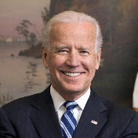
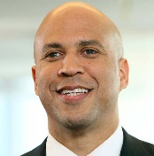
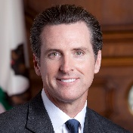
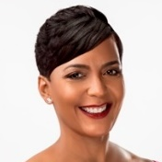
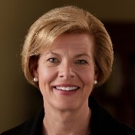
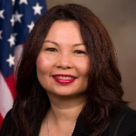
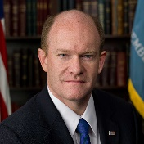
Thursday, August 20: “America’s Promise”
Key events
Acceptance speech by presidential nominee Joe Biden
Adjournment
Confirmed speakers
Former Vice President Joe Biden
Senator Cory Booker (D-NJ)
Governor Gavin Newsom (D-CA)
Atlanta Mayor Keisha Lance Bottoms
Senator Tammy Baldwin (D-WI)
Senator Tammy Duckworth (D-IL)
Senator Chris Coons (D-DE)
Senator Kamala Harris (D-CA)
Sources: Democratic National Convention.
Slide last updated on: August 12, 2020
Notes:
“’Uniting America’—Democrats Announce Themes for Four Nights of Convention,” Democratic National Convention, August 7, 2020, https://www.demconvention.com/press-releases/uniting-america-democrats-announce-themes-for-four-nights-of-convention/.
“Democratic National Convention Announces 2020 Convention Officers, Schedule of Events,” Democratic National Convention, July 30, 2020, https://www.demconvention.com/press-releases/democratic-national-convention-announces-2020-convention-officers-schedule-of-events/.
“Democratic National Convention Schedule,” Democratic National Convention, accessed August 12, 2020, https://www.demconvention.com/schedule-and-speakers/?_sft_event-day=august-20.

Slide 15
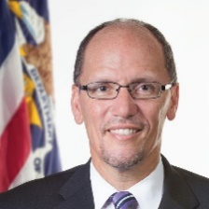
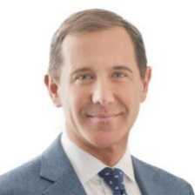
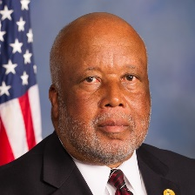
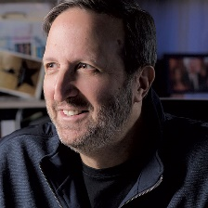
2020 Democratic National Convention leadership
Tom Perez
DNC Chair
Joe Solmonese
Convention CEO
Bennie Thompson (D-MS-02)
Permanent convention chair
Ricky Kirshner
Programming
Permanent Officers of the 2020 Democratic National Convention
Speaker Nancy Pelosi (D-CA-12) and Min. Leader Chuck Schumer (D-NY)
Honorary Chairs
Governor Phil Murphy (NJ)
Permanent Co-chair
Senator Tammy Duckworth (D-IL)
Permanent Co-chair
Senator Tom Carper (D-DE)
Permanent Co-chair
Milwaukee Mayor Tom Barrett
Permanent Co-chair
Atlanta Mayor Keisha Lance Bottoms
Permanent Co-chair
Rep. Tony Cárdenas (D-CA-29)
Permanent Co-chair
Senator Bob Casey (D-PA)
Vice Chair
Rep. Sharice Davids (D-KS-03)
Vice Chair
Rep. Donna Shalala (D-FL-27)
Vice Chair
Former Rep. Carol Shea-Porter (D-NH-01)
Vice Chair
Lt. Governor Mandela Barnes (WI)
Vice Chair
Lt. Governor Kate Marshall (NV)
Vice Chair
Lt. Governor Garlin Gilchrist (MI)
Vice Chair
Former Rep. Tony Coelho (D-CA-15)
Vice Chair
Jason Rae
Secretary
Rep. Steny Hoyer (D-MD-05)
Parliamentarian
Helen McFadden
Parliamentarian
Sarah Merkel
Parliamentarian
State Senator Yvanna Cancela (NV)
Parliamentarian
Sources: Democratic National Convention, Milwaukee Journal Sentinel.
Slide last updated on: August 10, 2020
Notes:
“Democratic National Convention Announces 2020 Convention Officers, Schedule of Events,” Democratic National Convention, July 30, 2020, https://www.demconvention.com/press-releases/democratic-national-convention-announces-2020-convention-officers-schedule-of-events/.
“Anchored in Milwaukee, 2020 Democratic National Convention will be a “Convention Across America,”” Democratic National Convention, June 24, 2020, https://www.demconvention.com/press-releases/anchored-in-milwaukee-2020-democratic-national-convention-will-be-a-convention-across-america/.
Bill Glauber, “Joe Solmonese named chief executive of 2020 Milwaukee Democratic convention,” Milwaukee Journal Sentinel, March 26, 2019, https://www.jsonline.com/story/news/politics/elections/2019/03/26/dnc-joe-solmonese-named-chief-executive-2020-milwaukee-convention/3277199002/.

Slide 16
Committee and party platform overview
Committees
162 base members, casting a total 158.25 votes, with the same distribution formula used to allocate delegates to the convention and elected by each state’s National Convention delegates
25 PLEOs, who are party leaders and elected officials that cast one vote each, elected by the Executive Committee of the Democratic National Committee (DNC)
Members do not necessarily need to be delegates or alternates to the Democratic National Convention
All three committees issue final reports that are voted on by the delegation as a whole
Platform Committee: Responsible for drafting and recommending the Platform of the Democratic Party to the Democratic National Convention
Co-Chairs: Julie Chavez Rodriguez, Obama administration White House executive
Dennis McDonough, Obama administration White House Chief of Staff
Platform Drafting Subcommittee: 15 members appointed by the Platform Committee Chair and DNC Chair; each presidential candidate may also appoint one non-voting member
Rules Committee: Issues a report to the Democratic National Convention, recommending Permanent Rules of the Convention, Convention agenda and amendments to the Charter of the Democratic Party of the United States
Co-Chairs: Maria Cardona, political strategist
Barney Frank, former US Representative (D-MA-4)
Credentials Committee: Issues a report that resolves questions and issues related to the seating of delegates
Co-Chairs: Lorraine Miller, former House of Representatives Clerk
James Roosevelt Jr., DNC Rules and Bylaws Committee co-chair
Sources: Democratic Party of the United States, Washington Post, Ballotpedia, Democratic National Convention, ABCNews.
Slide last updated on: August 12, 2020
Notes:
Michael Scherer, “Democrats propose new draft to party platform, revealing shifts in focus since 2016,” Washington Post, July 22, 2020,
https://www.washingtonpost.com/politics/democrats-propose-new-draft-to-party-platform-revealing-shifts-in-focus-since-2016/2020/07/22/e9fc9062-cbbe-11ea-bc6a-6841b28d9093_story.html
“Call for the 2020 National Convention,” Democratic Party of the United States, August 25, 2018,
https://democrats.org/wp-content/uploads/sites/2/2019/07/2020-Call-for-Convention-WITH-Attachments-2.26.19.pdf
“The Democratic Party Platform, 2020” Ballotpedia, accessed August 12, 2020,
https://ballotpedia.org/The_Democratic_Party_Platform,_2020
“The Democratic Party Platform: Our Roadmap for Moving America Forward,” Democratic National Convention, July 9, 2020,
https://www.demconvention.com/blog/the-democratic-party-platform-our-roadmap-for-moving-america-forward/
Molly Nagle, Kendall Karson, Joghn Verhovek, and Beatrice Peterson, “Biden will no longer tracel to DNC to accept Democratic nomination amid pandemic,” ABCNews, August 5, 2020,
https://abcnews.go.com/Politics/biden-longer-travel-milwaukee-dnc-convention-amid-coronavirus/story?id=72190484&cid=social_twitter_abcn

Slide 17
The 2020 platform draft was released on July 27
Platform process
The 2020 Platform
On June 23, the DNC announced the members of the Platform Drafting Subcommittee; the Chair is Atlanta Mayor Keisha Lance Bottoms
The draft of the 2020 platform was released July 27, prior to a meeting with the full Platform Committee
The platform includes many components from a report issued by the Biden-Sanders Unity Task Force, in an attempt to bridge the gap between the progressive and moderate factions of the party
In the July 27 Platform Committee meeting, members approved language to oppose the Trump administration’s deployment of federal troops to quell protests, support for unions, and expanding paid sick leave
The draft endorses universal health care and calls for a public option to the existing ACA; however, over 700 delegates joined a pledge to “vote against any platform that does not include support for universal single-payer Medicare for All”
Voting on the platform will take place remotely from August 3-15
The DNC Chair distributes an outline of the issues to be considered by the committee prior to the first Platform Committee meeting
1
2
The Platform Drafting Subcommittee drafts the report of the Platform Committee under the direction and with the approval of the full Platform Committee
3
A minority report will be prepared if requested by 25% of the votes on the Platform Committee
4
The Platform Committee Chairs present the committee’s report to the Convention
5
The Platform is voted on, using email ballots, by the full body of convention delegates during the Democratic Convention
Sources: Democratic Party of the United States, Washington Post, Ballotpedia, Democratic National Convention, ABCNews, NPR.
Slide last updated on: August 12, 2020
Notes:
Scott Detrow, “Deomcrats meet virtually to approve platform that builds off Biden-Sanders effort,” NPR, July 27, 2020,
https://www.npr.org/2020/07/27/895800425/democrats-meet-virtually-to-approve-platform-that-builds-off-of-biden-sanders-ef
Michael Scherer, “Democrats propose new draft to party platform, revealing shifts in focus since 2016,” Washington Post, July 22, 2020,
https://www.washingtonpost.com/politics/democrats-propose-new-draft-to-party-platform-revealing-shifts-in-focus-since-2016/2020/07/22/e9fc9062-cbbe-11ea-bc6a-6841b28d9093_story.html
“Call for the 2020 National Convention,” Democratic Party of the United States, August 25, 2018,
https://democrats.org/wp-content/uploads/sites/2/2019/07/2020-Call-for-Convention-WITH-Attachments-2.26.19.pdf
“The Democratic Party Platform, 2020” Ballotpedia, accessed August 12, 2020,
https://ballotpedia.org/The_Democratic_Party_Platform,_2020
“The Democratic Party Platform: Our Roadmap for Moving America Forward,” Democratic National Convention, July 9, 2020,
https://www.demconvention.com/blog/the-democratic-party-platform-our-roadmap-for-moving-america-forward/
Molly Nagle, Kendall Karson, Joghn Verhovek, and Beatrice Peterson, “Biden will no longer tracel to DNC to accept Democratic nomination amid pandemic,” ABCNews, August 5, 2020,
https://abcnews.go.com/Politics/biden-longer-travel-milwaukee-dnc-convention-amid-coronavirus/story?id=72190484&cid=social_twitter_abcn

