Slide 1
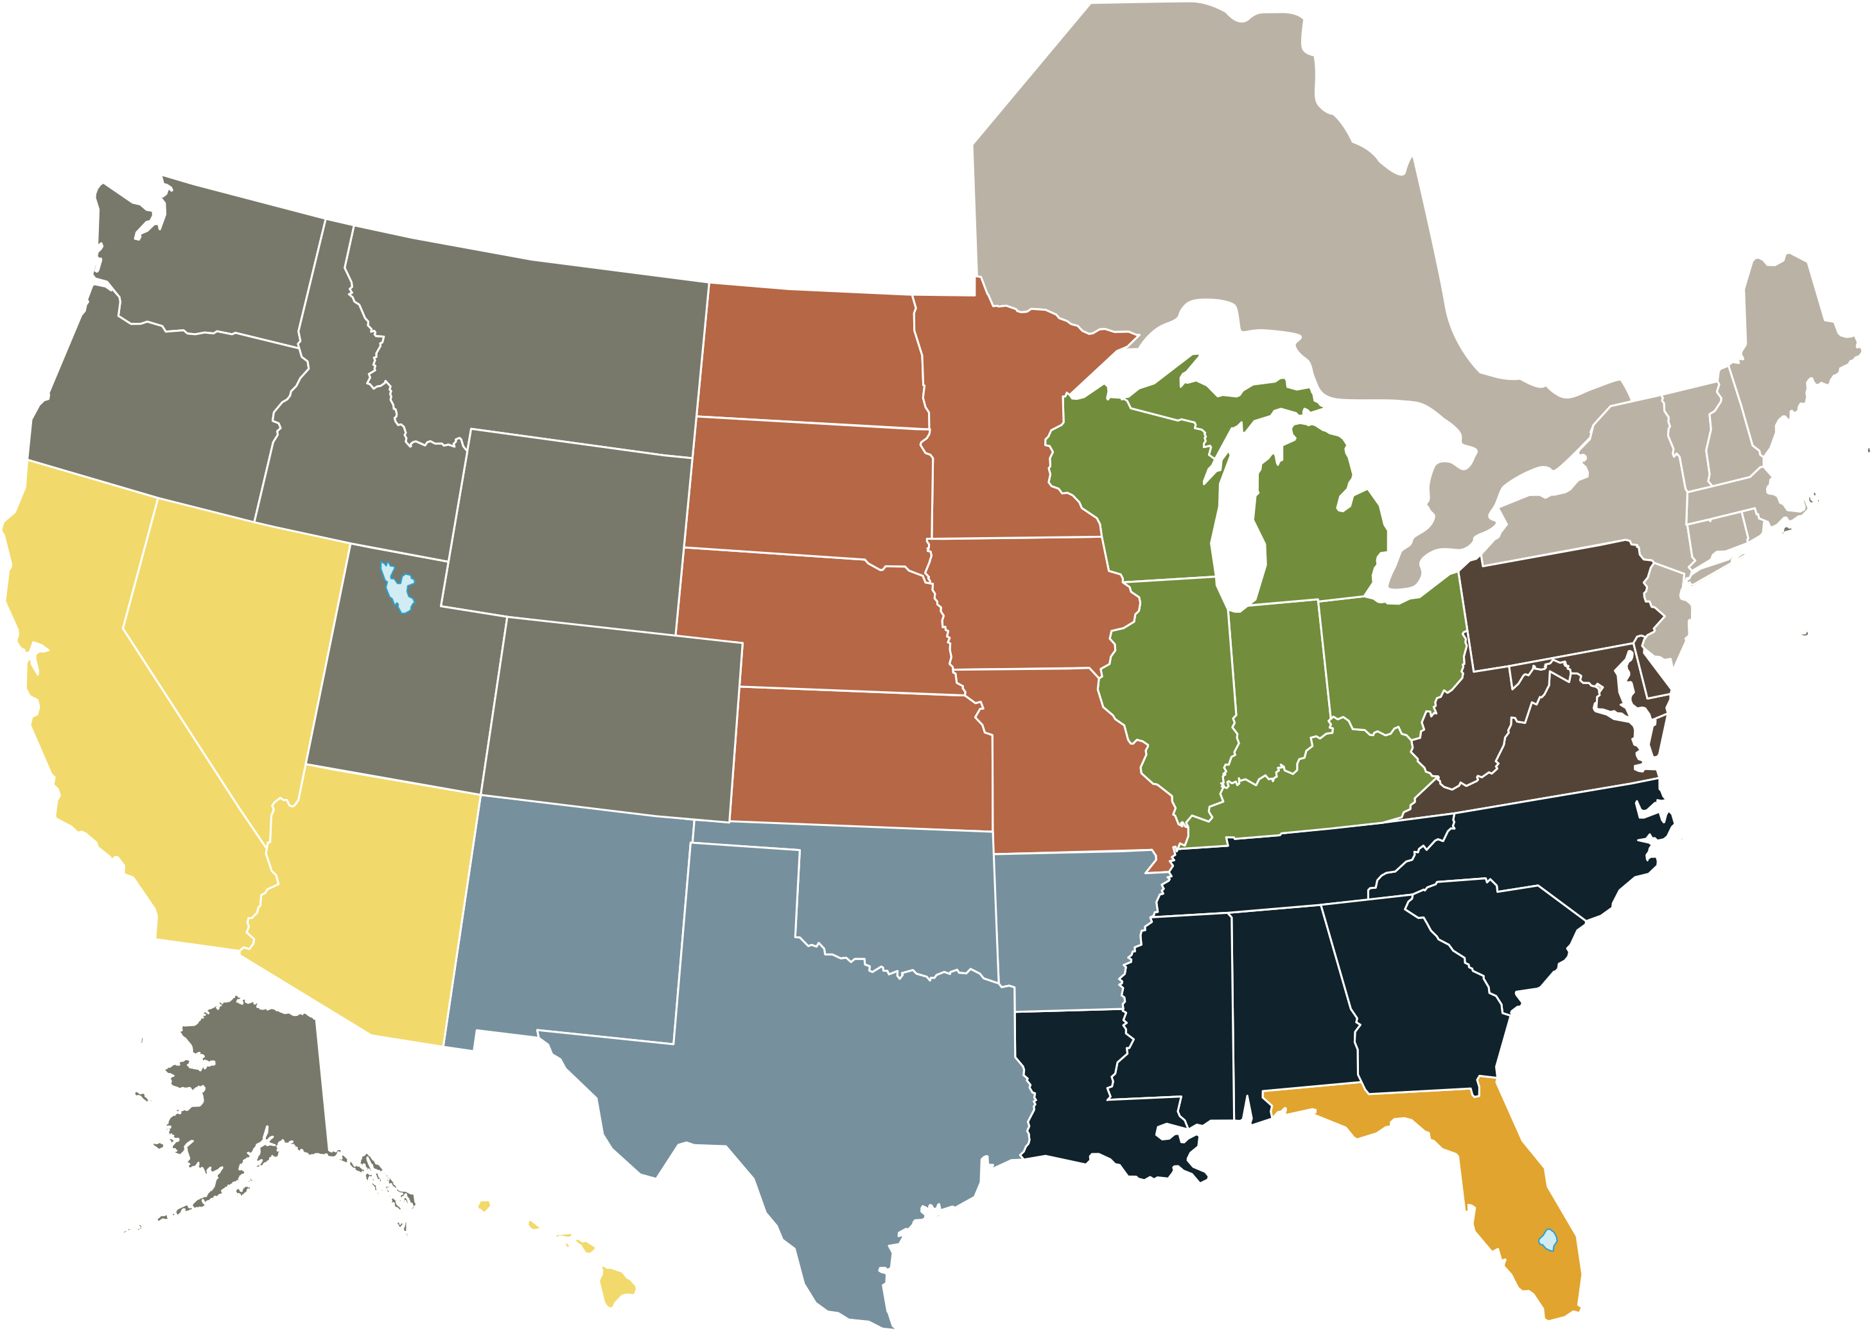
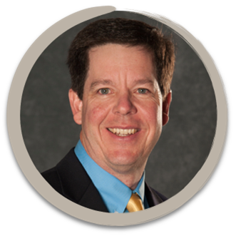
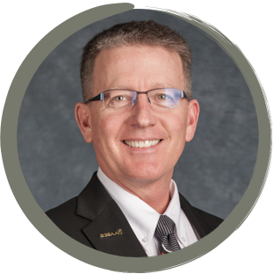
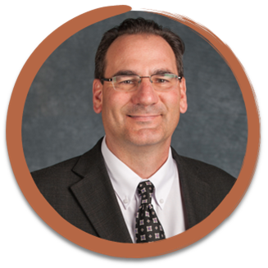
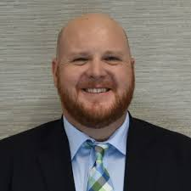

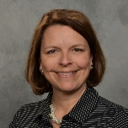

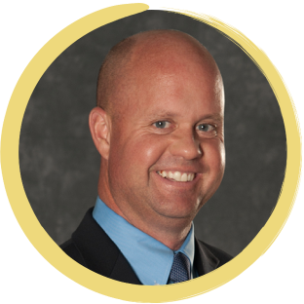


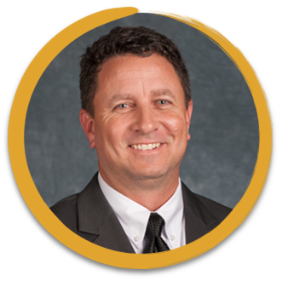
Chapter Outreach Update

Slide 2
Strategic Planning/Board Orientation

Slide 3
Facility Visits – Membership Recruitment

Slide 4
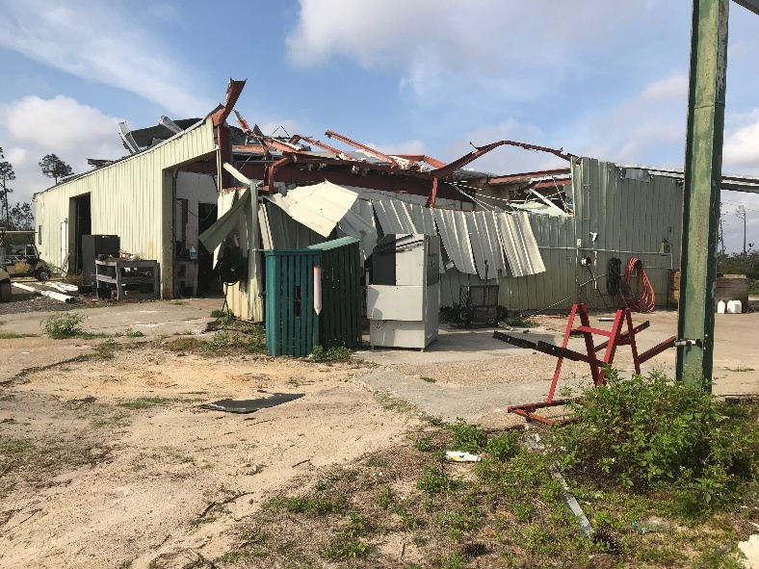
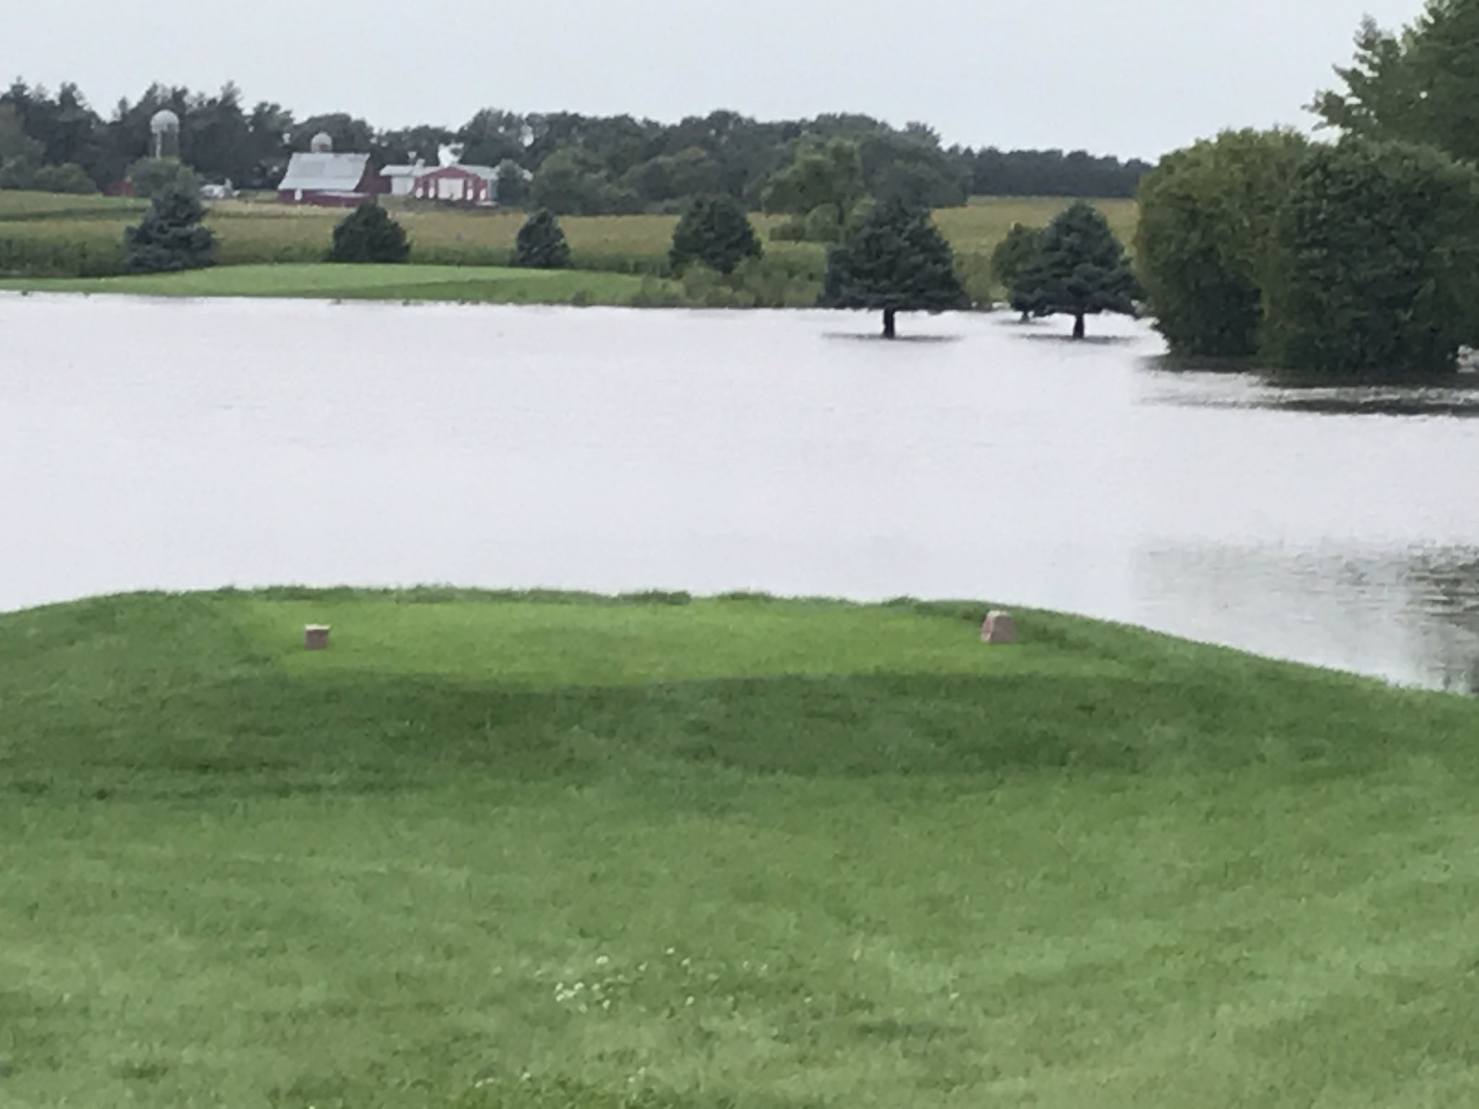
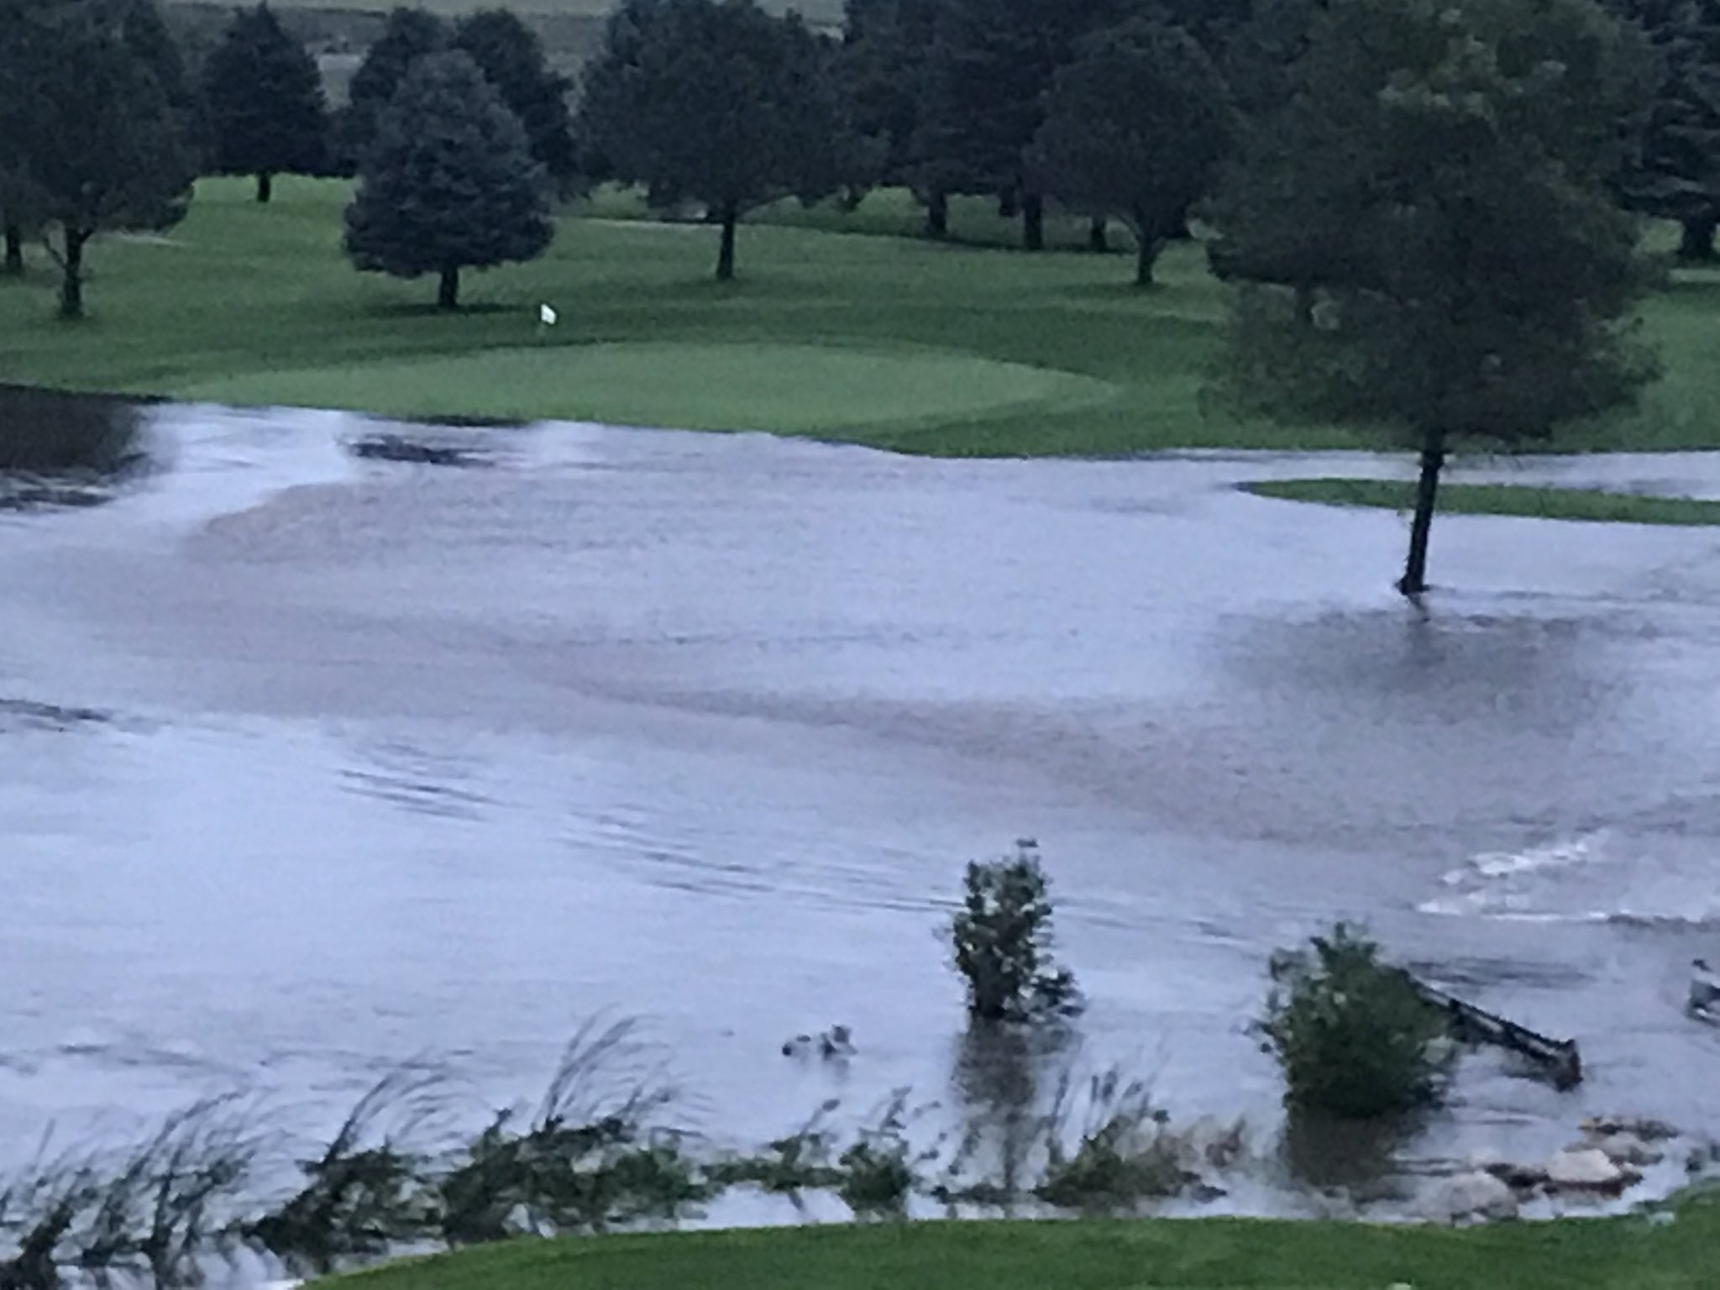
Outreach After Disasters

Slide 5
Advocacy Efforts/Promoting the Profession

Slide 6
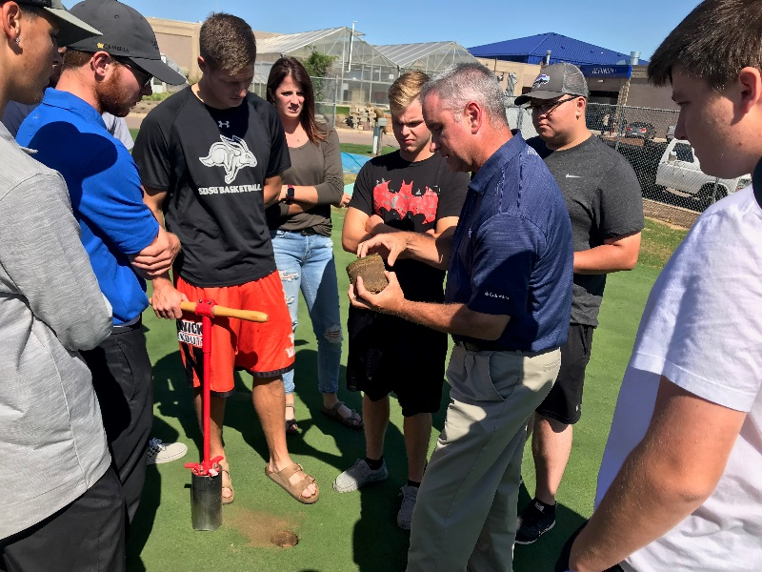
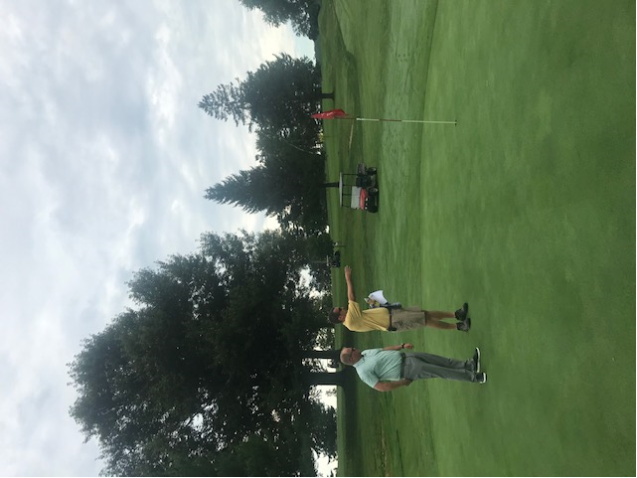
Board Outreach Visits

Slide 7
Working at Various Championships

Slide 8

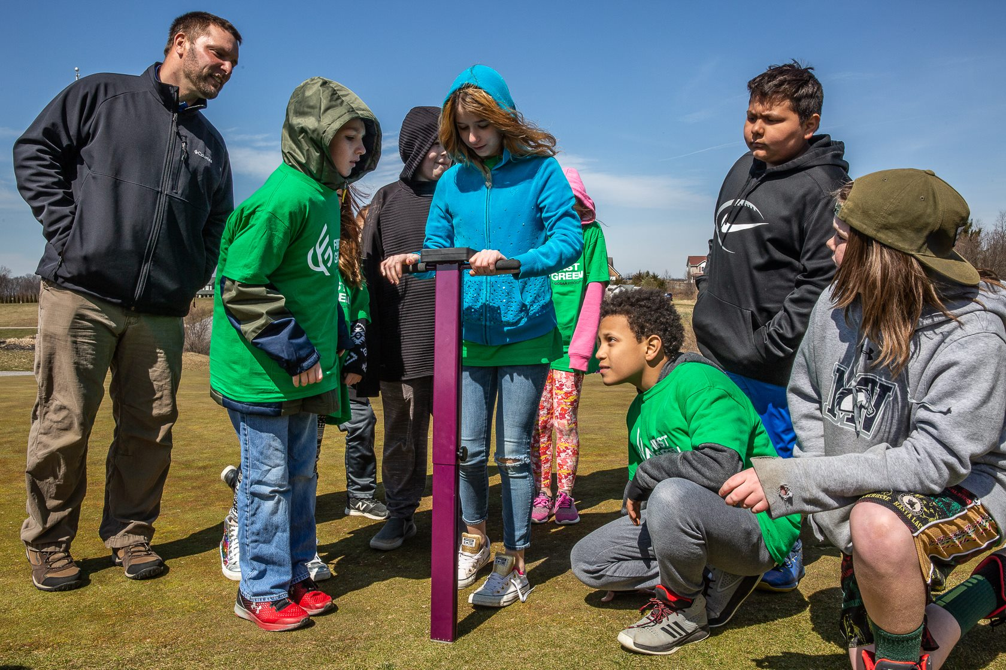
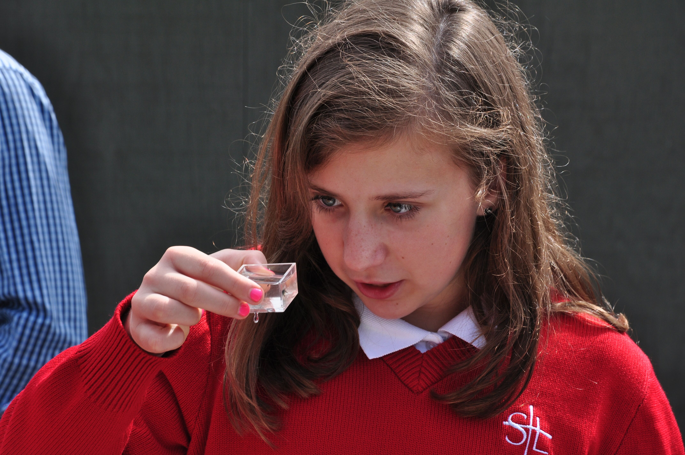
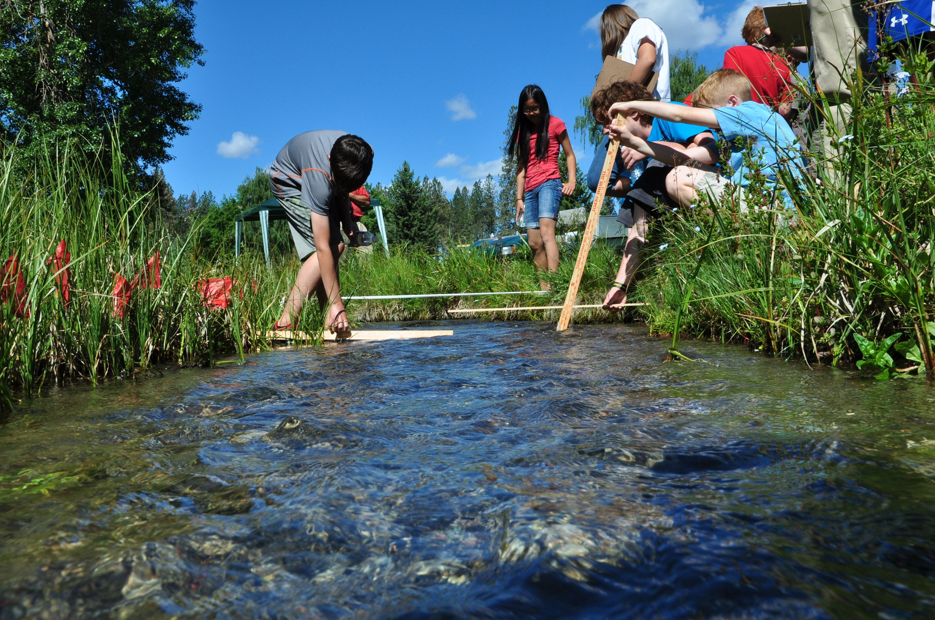
First Green
GCSAA’s First Green program is a science, technology, engineering and math (STEM) environmental outreach program that uses the golf course as a living laboratory. K-12 students participate in hands-on learning stations.

Slide 9
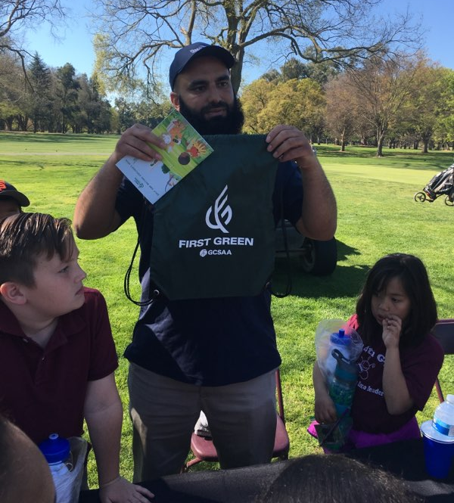
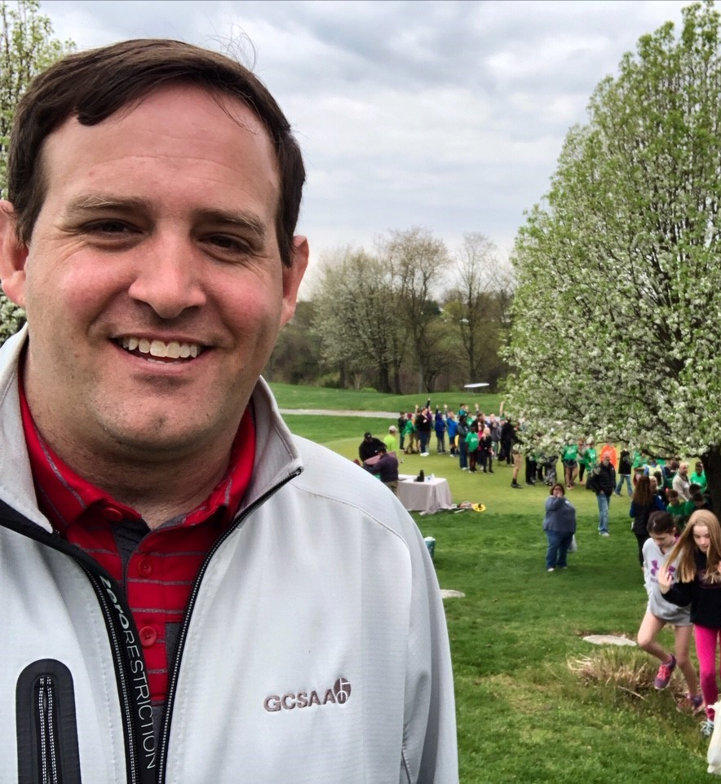
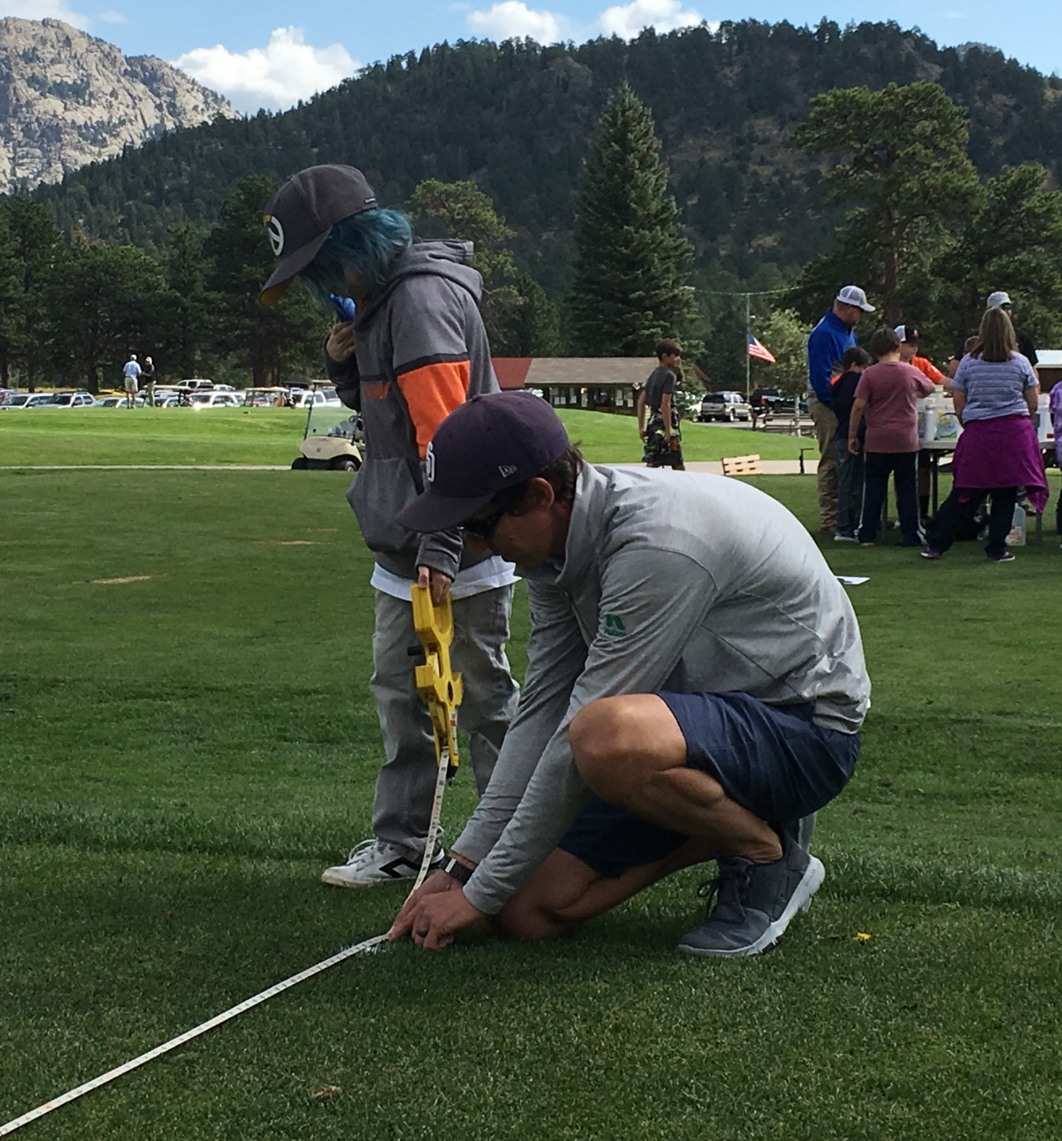

First Green Liaisons
$500 Grants (limited)
Swag bags
Field Staff
Thefirstgreen.org – lesson plans; ideas

Slide 10
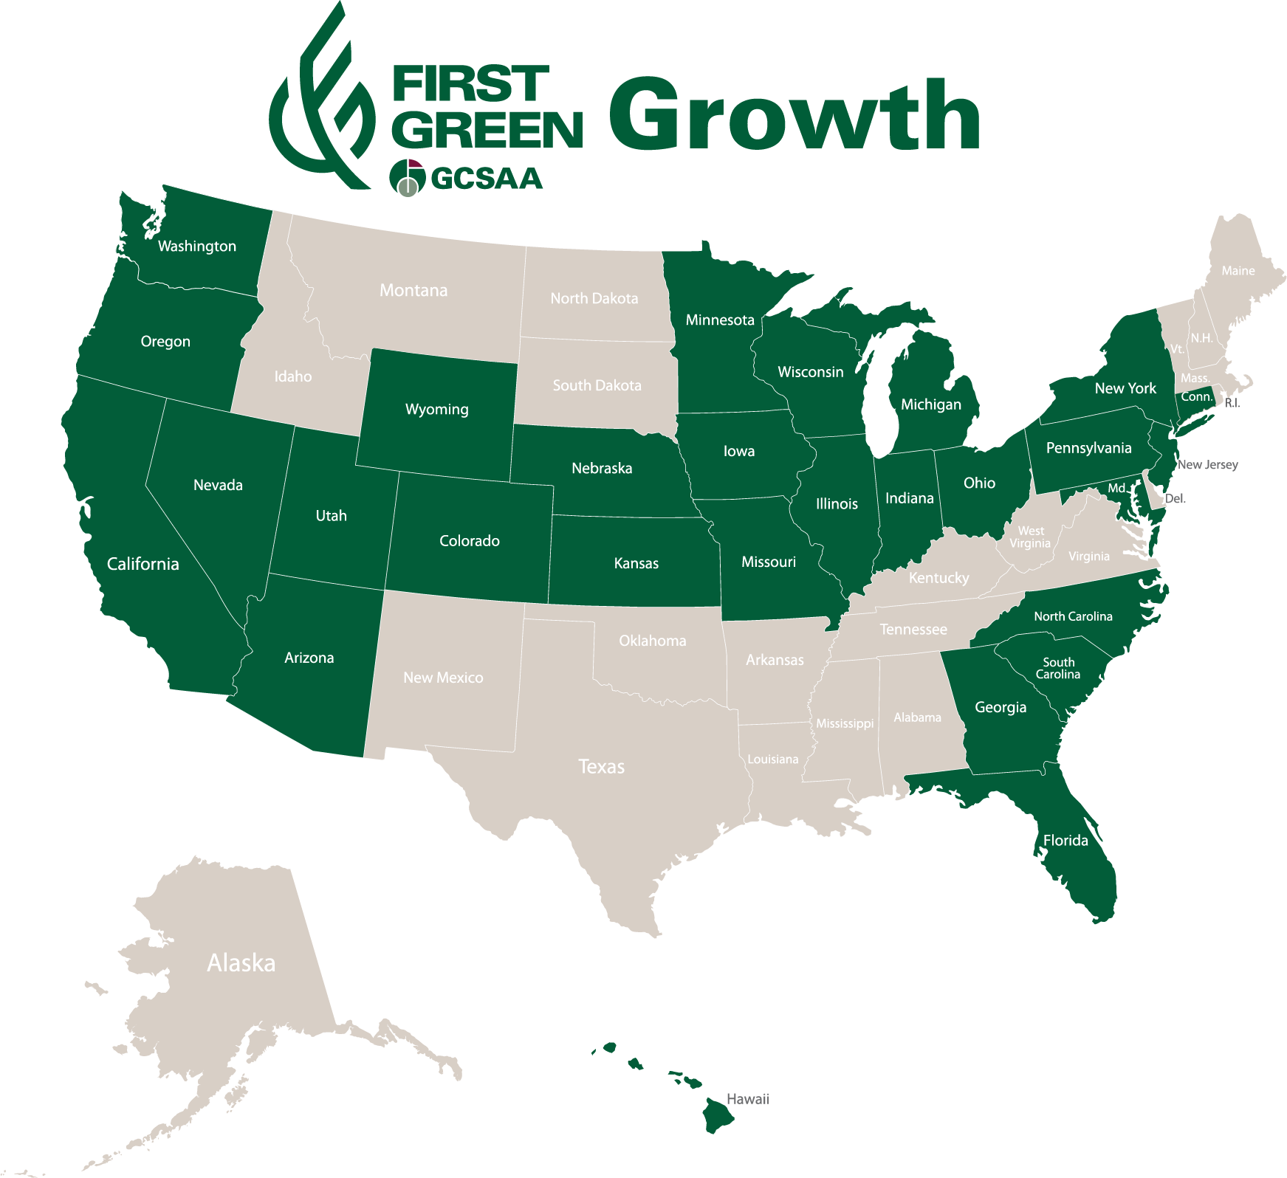
Aug. 2018 – Nov. 1, 2021
81 field trips to date
28 states
Over 4,000 students
3 field trips in 2020.
2021
Off to a slow start. Most schools did not allow spring field trips.
Over 1,000 students have participated in 25 field trips covering 17 states.
New - Piloting LPGA/USGA Girls Golf Club field trips for Summer outreach.
First Green Field Trips
No Field Trips
Notes:
Just under three years we’ve had 67 field trips to date. We are scheduled to have an additional 4 field trips by the end of 2021. 25 states and looking to expand.

Slide 11
Chapter Outreach Task Group
2022 Objectives
Review current affiliation agreement/recommend updates
Boost chapter engagement with events
Discuss objectives of Field Staff efforts
Strategic partnerships with local allied golf organizations
Promoting Board Orientation and Strategic Planning to chapters
Composition:
  Chair and Vice-Chair, 3 GCSAA Superintendents, 1 GCSAA Assistant Superintendent, 3 Chapter Executives

Slide 12
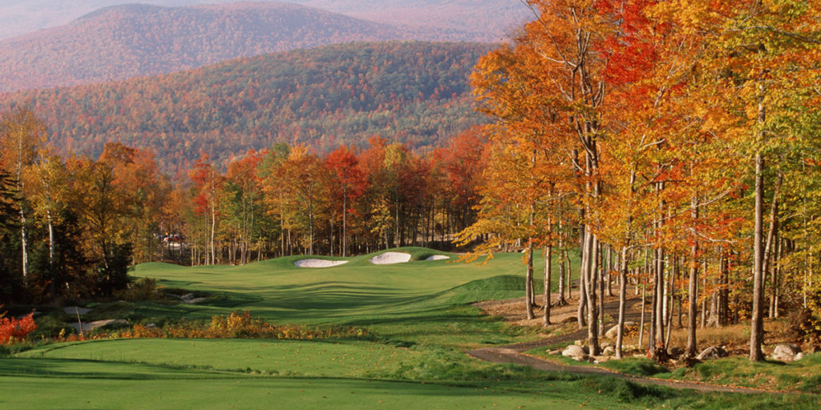


THANK YOU

